Slide 1
RMS SOP
Bert Hu
SMD
Notes:
In 3-raw heading uses font 84, 1 raw and 2-raws use font 88

Slide 2
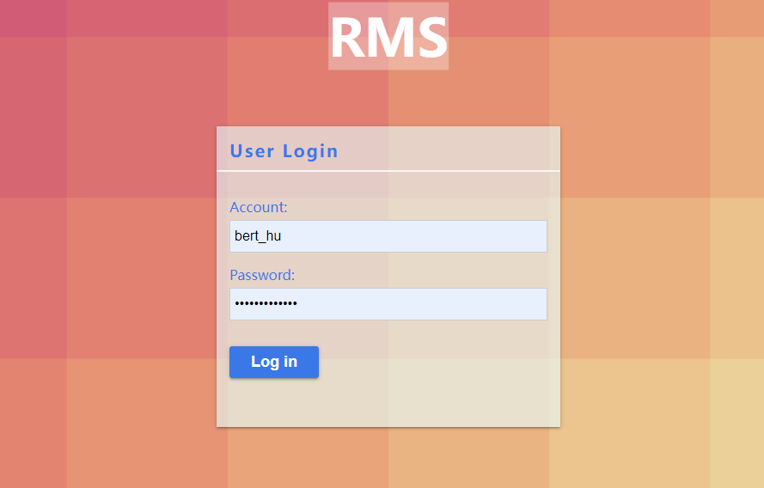
1.Login
Log in to the system using your domain account
If you do not have a domain account, please apply for a system account from the administrator

Slide 3
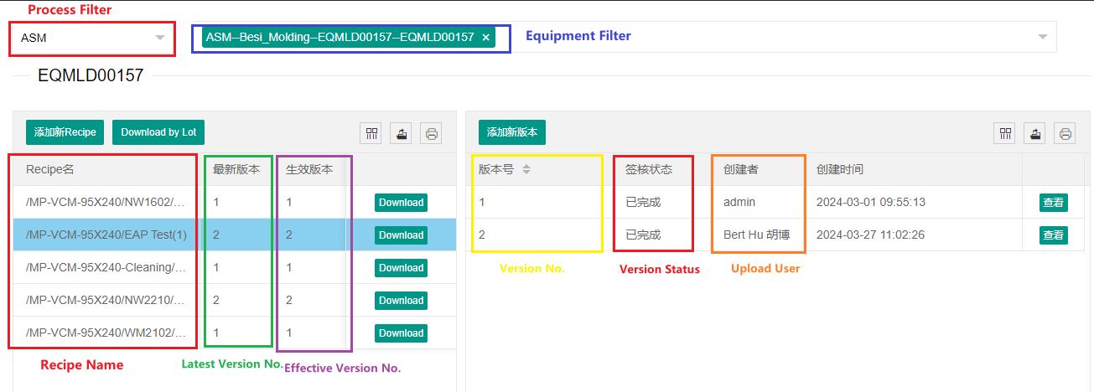
2.Recipe Manage – Version Manage
Only the Effective version can be downloaded to machine.

Slide 4
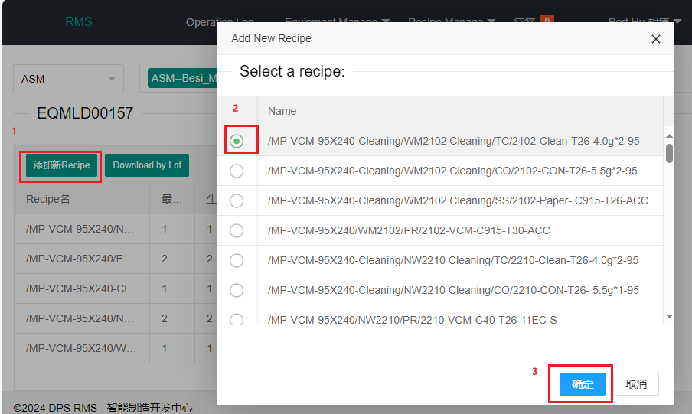
2.1Recipe Manage – Version Manage – Add new recipe(1/1)
If the recipe has already been uploaded, please go to ‘Add new version’

Slide 5
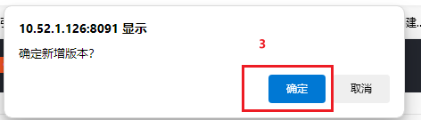
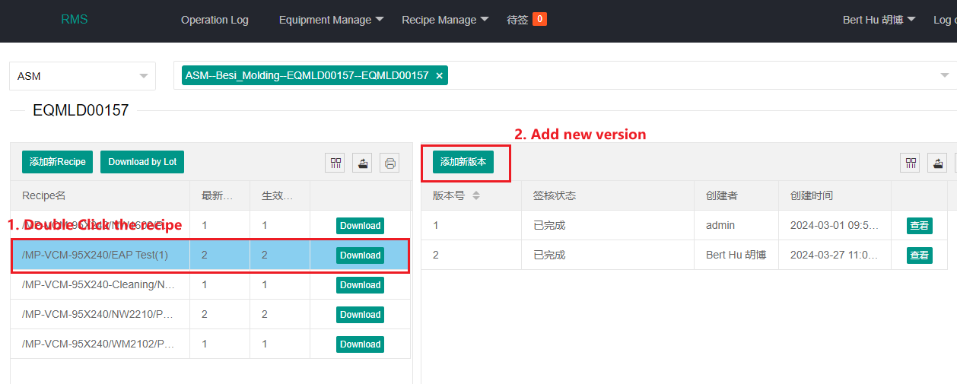
2.2Recipe Manage – Version Manage – Add new version(1/2)

Slide 6
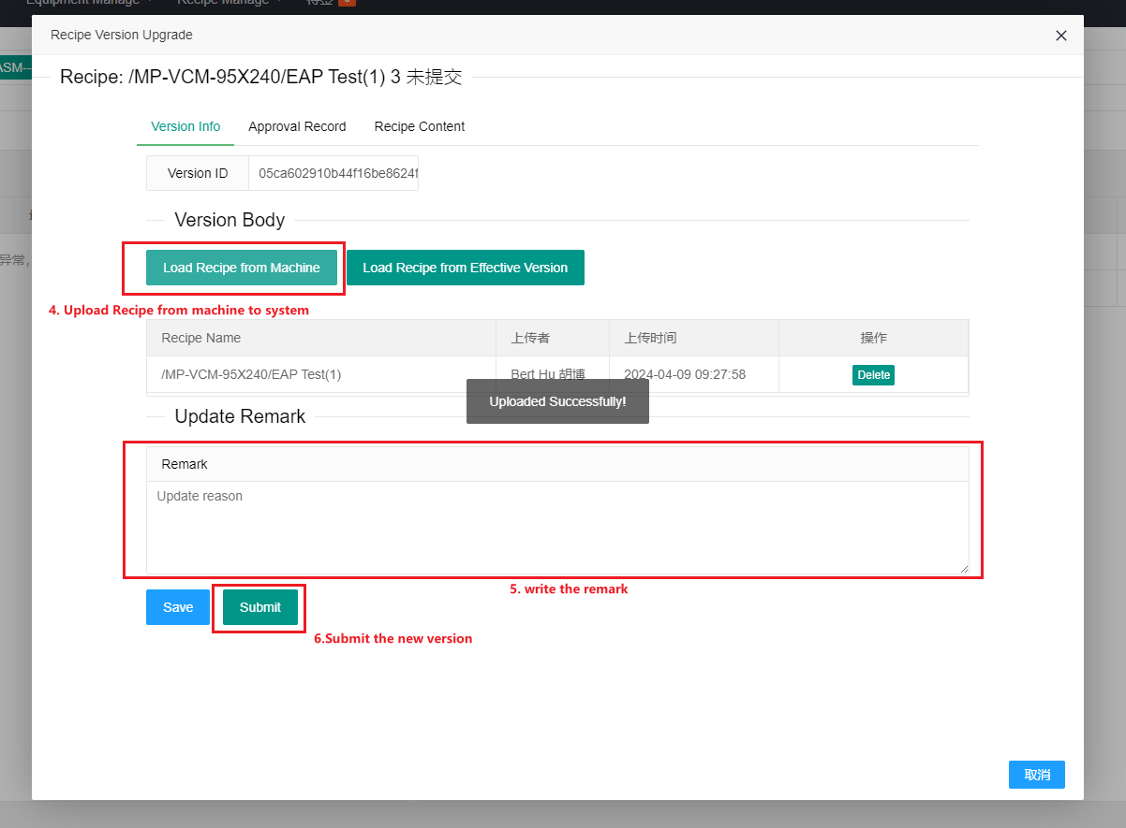
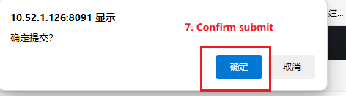
2.2Recipe Manage – Version Manage – Add new version(2/2)

Slide 7
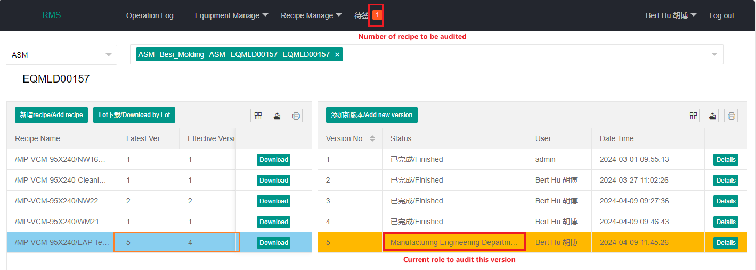
2.3 Recipe Manage – Version Audit – Version Approval(1/2)

Slide 8
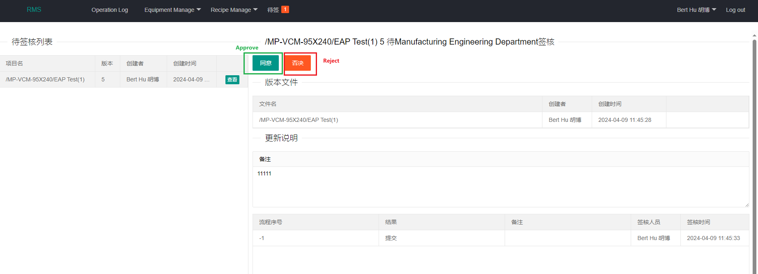
2.3 Recipe Manage – Version Audit – Version Approval(2/2)

Slide 9
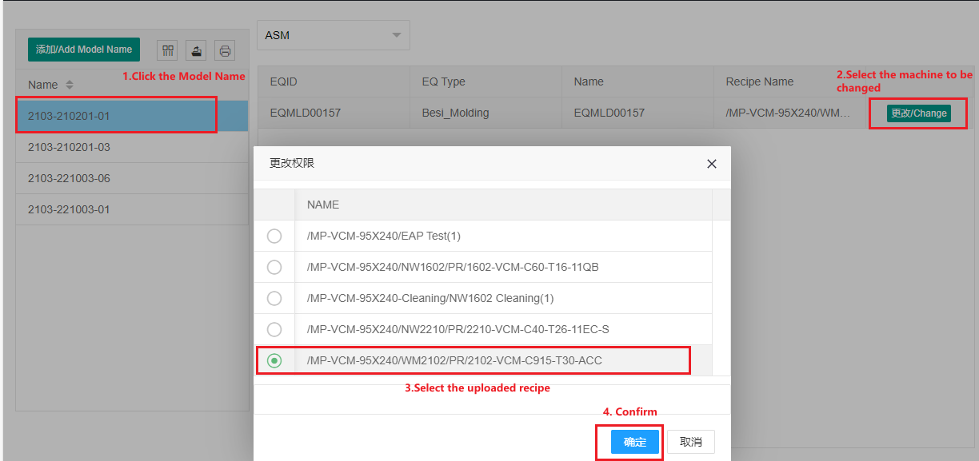
2.4 Recipe Manage – Model Name Link(1/1)

